Slide 1
OOAD
Developing Requirements
System Requirements

Slide 2
Requirements engineering
The process of establishing the services that the customer requires from a system and the constraints under which it operates and is developed
2 types of requirements classifications
  Functional requirements describe system functions
  Non-functional requirements are constraint on the system
A requirement may therefore be an abstract statement of a system service or may be a system constraint or even a mathematical functional specification
Notes:
Non-functional requirements define system properties and constraints e.g. reliability, response time and storage requirements. Constraints are I/O device capability, system representations. They are much more critical than functional requirements. The system is useless if they are not met.

Slide 3
Requirements Documents
User requirements
  Statements in natural language plus diagrams of the services the system provides and its operational constraints. Written for customers.
System requirements
  A structured document setting out detailed descriptions of the system’s functions, services and operational constraints. Defines what should be implemented so may be part of a contract between client and contractor.
Notes:
Sets of documentation produced by developers. System requirements is produced from user requirements after requirements had been gathered.

Slide 4
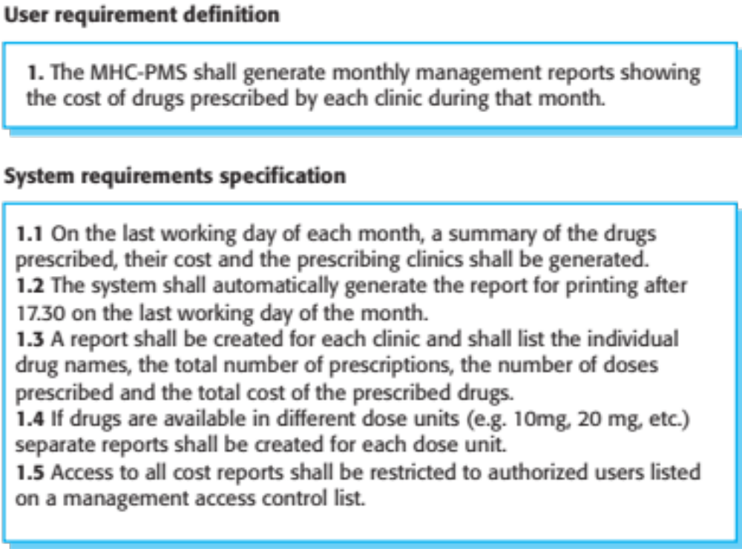
Eg. User & System Requirements
Notes:
MHC-PM5 is the name of the system in question. Its used by clinics to keep track of medicine dispensed.
User requirements are normally abstract/ shallow and straight forward for the system user perspective.
System requirements specification are detailed and exact. They are an expansion of the user requirements from the view point of the developer. Normally done when requirements are being engineered

Slide 5
Requirements Engineering (RE) process
RE is a spectrum of tasks and techniques that lead to an understanding of requirements
The processes used for RE vary widely depending on the application domain, the people involved and the organisation developing the requirements.
However, there are a number of generic activities common to all processes
  Requirements elicitation;
  Requirements elaboration;
  Requirements validation;
  Requirements management.
In practice, RE is an iterative activity in which these processes are interleaved.
Notes:
RE is the process of dissecting clients requirements with the intention of getting a much clearer and better view of them.

Slide 6
RE activities expansion
Requirement elicitation: Involves technical staff working with customers to find out about the application domain, the services that the system should provide and the system’s operational constraints.
Requirement Elaboration: requirements from the elicitation is expanded and refined. Focuses on developing a refined requirement model, that identifies various aspects of s/w functions, behavior and information. Defines user scenario’s that describe how users will interact with the system

Slide 7
RE activities expansion..
Requirement Validation: validates work products produced from the elicitation and elaboration stage. Examines the s/w requirement specification to ensure that all s/w requirements have been stated unambiguously; that inconsistencies, omissions, and errors have been detected and corrected
Requirement Management: performs a set of activities that help the project team identify, control and track requirements and changes to requirements at any time as project proceeds
Notes:
Validation looks at the documents (System Requirements Specification), to ensure that there is no ambiguity in the requirement

Slide 8
Elicitation and Elaboration
Software engineers work with a range of system stakeholders to find out about the application domain, the services that the system should provide, the required system performance, hardware constraints, other systems, etc.
Stages include:
  Requirements discovery,
  Requirements classification and organization,
  Requirements prioritization and negotiation,
  Requirements specification.

Slide 9
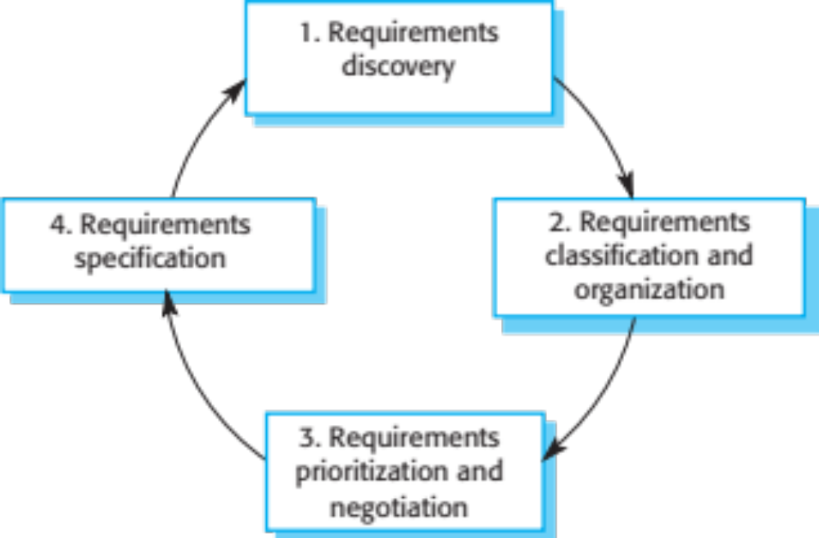
Elicitation and Elaboration process
Notes:
Requirement specification leads to production of a document called srs

Slide 10
Agile methods & RE
Many agile methods argue that producing a requirements document is a waste of time as requirements change so quickly.
The document is therefore always out of date.
Methods such as XP use incremental requirements engineering and express requirements as ‘user stories’.
This is practical for business systems but problematic for systems that require a lot of pre-delivery analysis (e.g. critical systems) or systems developed by several teams.

Slide 11
Requirements development: Use Cases
Use-cases are a scenario based technique in the UML which identify the actors in an interaction and which describe the interaction itself.
A set of use cases should describe all possible interactions with the system.
One would start by identifying actors involved in each scenario
Actors are different people or devices that use the system/ product
Actors represent the roles that people or devices play as the system operates
Notes:
RE may involve the use of use cases technique, which help elaborate requirements further

Slide 12
Use case diagrams
Use Case diagrams show the various activities the actors can perform on the system.
  System is something that performs a function.
Describe or capture functional requirements
They model the dynamic aspects of the system
Provides a user’s perspective of the system
They commonly contain
  Use cases
  Actors
  Relationships between use cases and actors

Slide 13
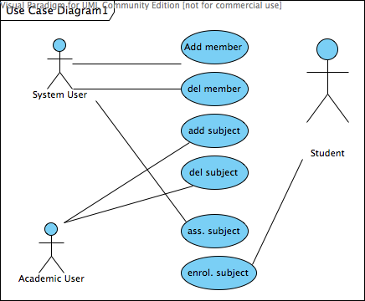
Use case diagram
Notes:
The diagram as a whole is called a use case diagram. It contains use cases, actors and their relationship with the use cases

Slide 14
Use case diagrams elements
A set of ACTORS: roles users can play in interacting with the system.
  An actor is used to represent something that uses our system
A set of USE CASES: each describes a possible kind of interaction between an actor and the system.
  Use cases are actions that a user takes on a system
A number of RELATIONSHIPS between the entities (actors and use cases).
  Relationships are simply illustrated with a line connecting actors to use cases

Slide 15

System actors
An actor is a user of the system playing a particular role.
Actor is shown with a stick figure.
Actors stimulate a system providing input events and or receive something output from the system
Actors communicate with a system by sending and receiving messages to/from it, while performing use cases
Actors model anything that needs to interact with the system to exchange information – human users, computer system and others

Slide 16

Use cases
A use case is a particular activity a user can do on the system.
Notice that use cases cannot be used to describe non-functional requirements of the system as those do not have actors
Represented by an ellipse

Slide 17
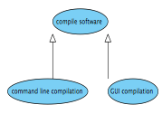
Use case relationships: GENERALIZATION
Kind of relationship that shows that a more specialized use case is related to a more general use case

Slide 18
Use case relationships: INCLUDE
One use case explicitly incorporates the behavior of another use case
The include relationship never stands alone, but is instantiated as part of some larger base of use cases.
  The called use case never stands alone, it is called by a caller use case
Notes:
States that when one use case executes, it explicitly causes the other use case to execute. Similar to when an object uses behavior in another object.
The called object will always return some result to the calling object

Slide 19
Use case relationships: EXTEND
One use case may implicitly incorporate the behavior of another use case
The extending use case may stand alone and usually executes without regards to extension points
Depending on the system behavior the extension use case will be executed or not

Slide 20
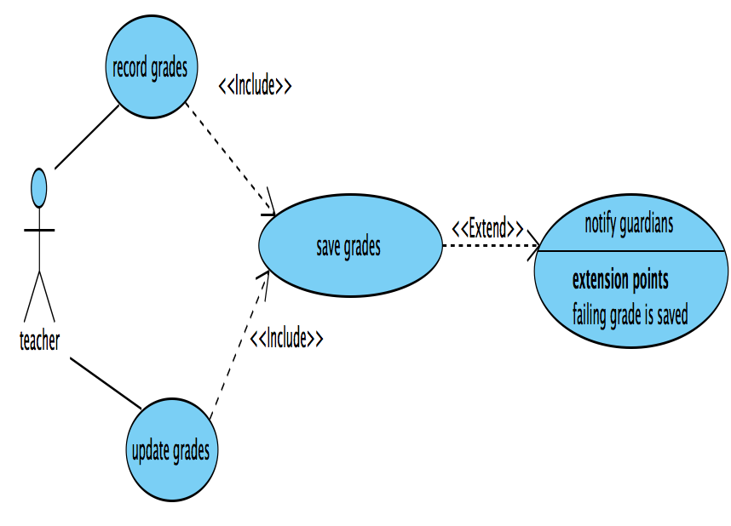
examples
Notes:
The extension point happens starting from notify guardians. The use case can be interrupted as: notify guardians when a failing grade is being saved

Slide 21
Identifying actors
Ask oneself the following questions:
what computers, subsystems and people will drive our system? (actors)
  examples: Customer, Clerk, Corporate Mainframe
what does each actor need our system to do?
  each need may show up as a trigger to a use case

Slide 22
Naming and identifying use cases
Use cases describe
  Functions that the user wants a system to accomplish
  The operations that create, read, update, delete information CRUD
  How actors are notified of the changes to the internal state and how they notify the system about external events
Use concrete verb-noun phrases from requirements to name use cases
  Verbs: create, calculate, report, record etc
  Nouns: property, payment, transcript, paper, system, data etc

Slide 23
References
selected from Ian Sommerville slides for “Software Engineering
OOAD with UML Training course, Adegboyega Ojo, Elsa Estevez

